Slide 1


What should Nintendo do?
By: Veena Chintala Prof: Dr. Siamak
MSBA: 320

Slide 2

Agenda
2
Research Question
Data Collection
Analysis
Conclusion & Recommendations

Slide 3
1.
Research Question
3

Slide 4
“
We are trying to predict the sales and make recommendations to Nintendo for the next 5 years.

Slide 5
2.
Data Collection
5

Slide 6

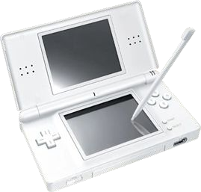
6
Dataset Description
▸ Video game sales, with review scores and ratings for 205 Nintendo games

Slide 7

Dataset Description
7
▸ Name
▸ Platform
▸ Year of
Release
▸ Developer
▸ Genre
▸ Critic Score (Metacritic)
▸ User Score (Metacritic)
▸ Rating (E, T, M, etc)
▸ North America Sales
▸ European Sales
▸ Japan Sales

Slide 8




8
BIG CONCEPT
Bring the attention of your audience over a key concept using icons or illustrations

Slide 9
9
3.
Analysis
Descriptive & Inferential Statistics

Slide 10
Data Preparation
10
Data Cleaning
Summary Statistics
Statistical Analysis
Recoding

Slide 11
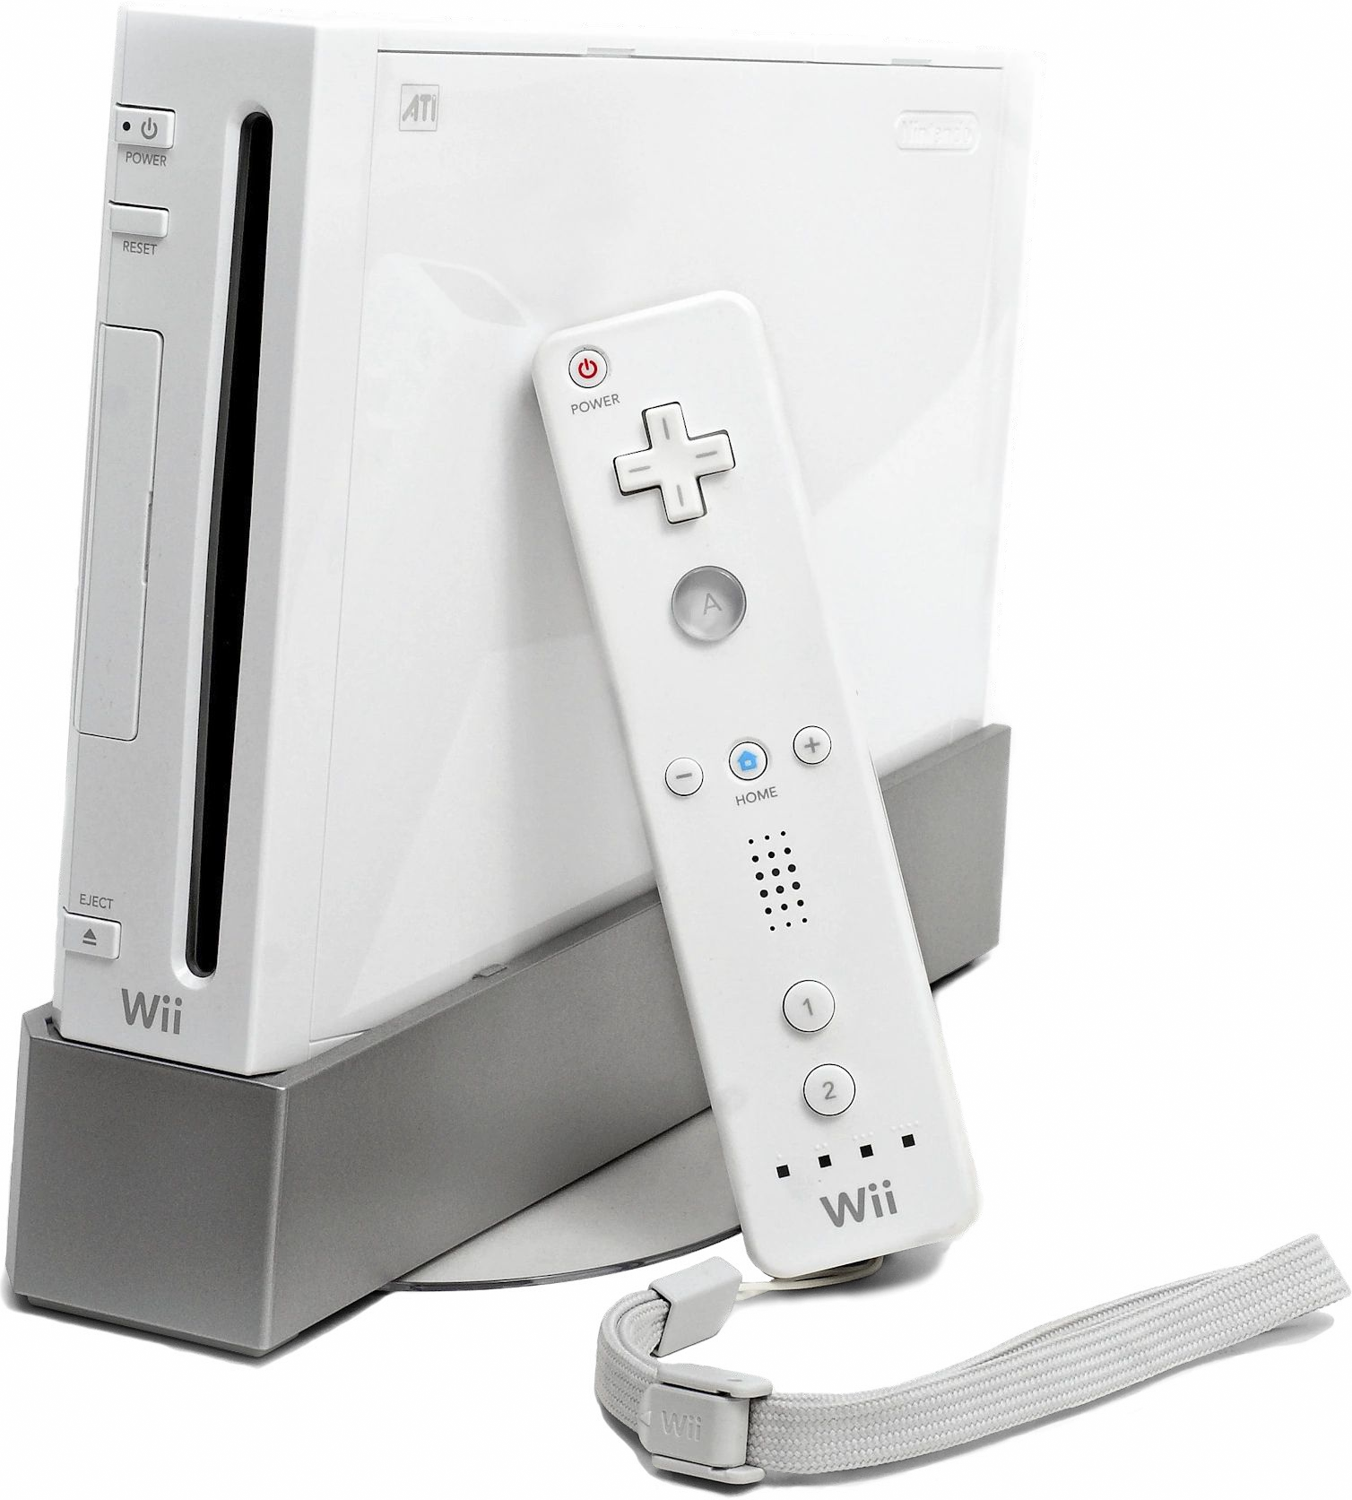
Dataset Description - Recode
11
▸ Platform Recode
▹ Wii/WiiU = 1
DS/3DS = 2
Console
Portable

Slide 12
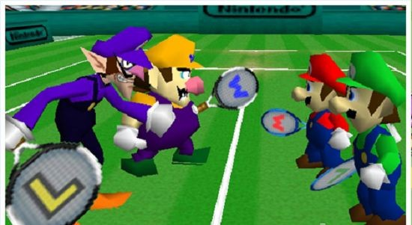
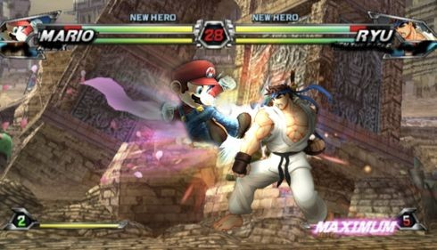



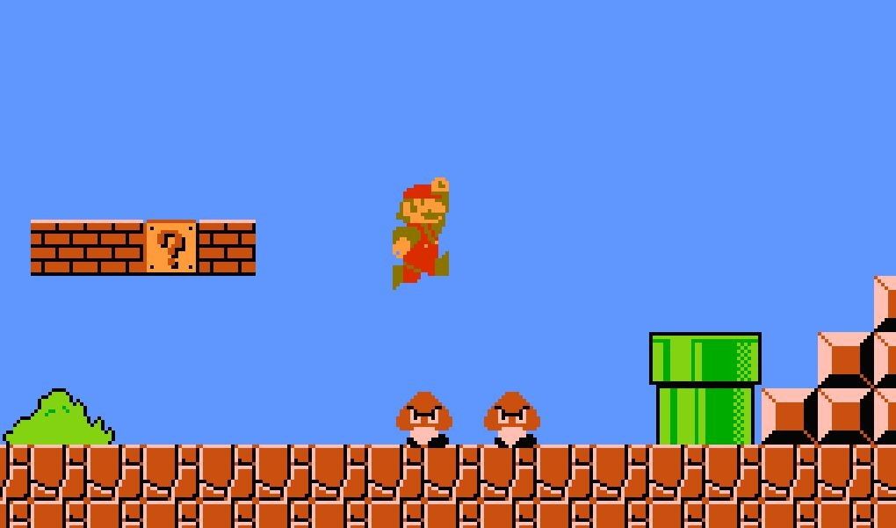
Dataset Description - Genre Recode
12
Action/Shooter/Fighting/ Adventure = 2
Sports/Racing = 1
Role-Playing/Strategy = 3
Misc/Puzzle = 4
Simulation = 5
Platform = 6

Slide 13
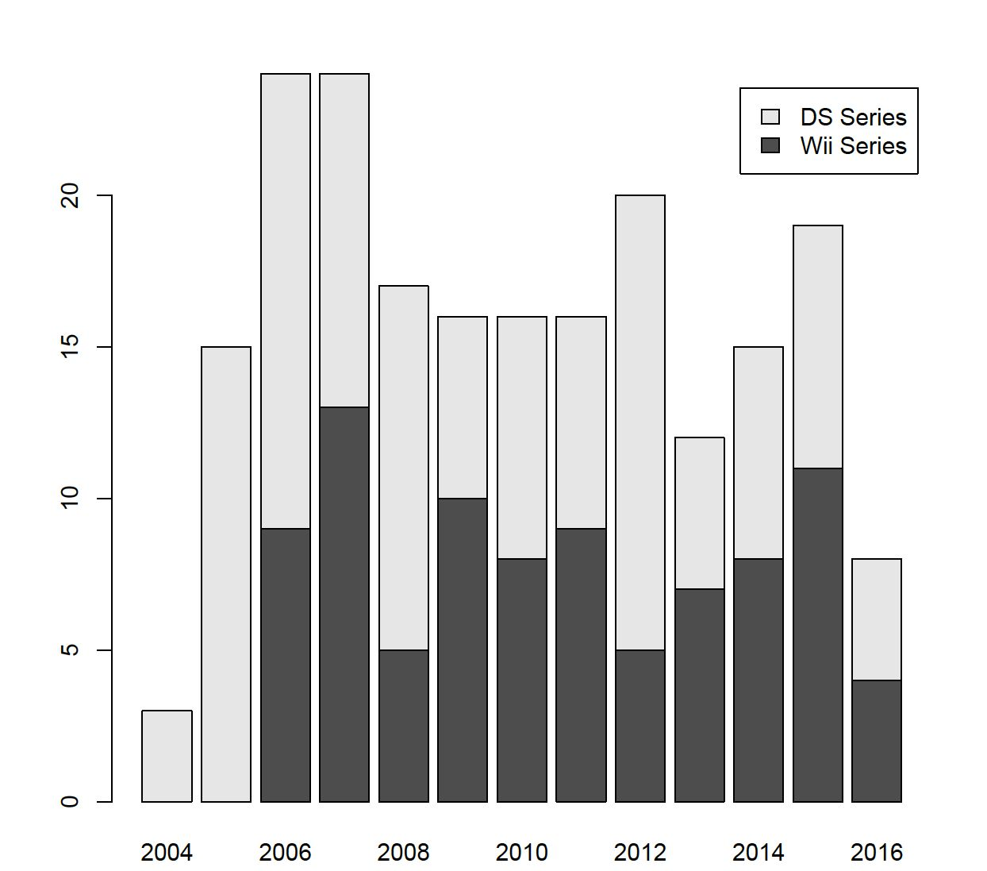
13
Barplot: Number of Games by Platform in Each Year
Console products are increasing!

Slide 14
Two Way Table
14
Count of Games by Rating in Each Genre
 | Sports | Actions/Adv enture | Role-Play/St rategy | Misc/Puzzle | Simulation | Platform
E | 21 | 15 | 15 | 43 | 8 | 24
T | 0 | 17 | 13 | 0 | 3 | 0
E10+ | 3 | 13 | 11 | 9 | 2 | 3
M | 0 | 3 | 0 | 0 | 0 | 0

Slide 15
Console games are more popular in North America
15

Slide 16
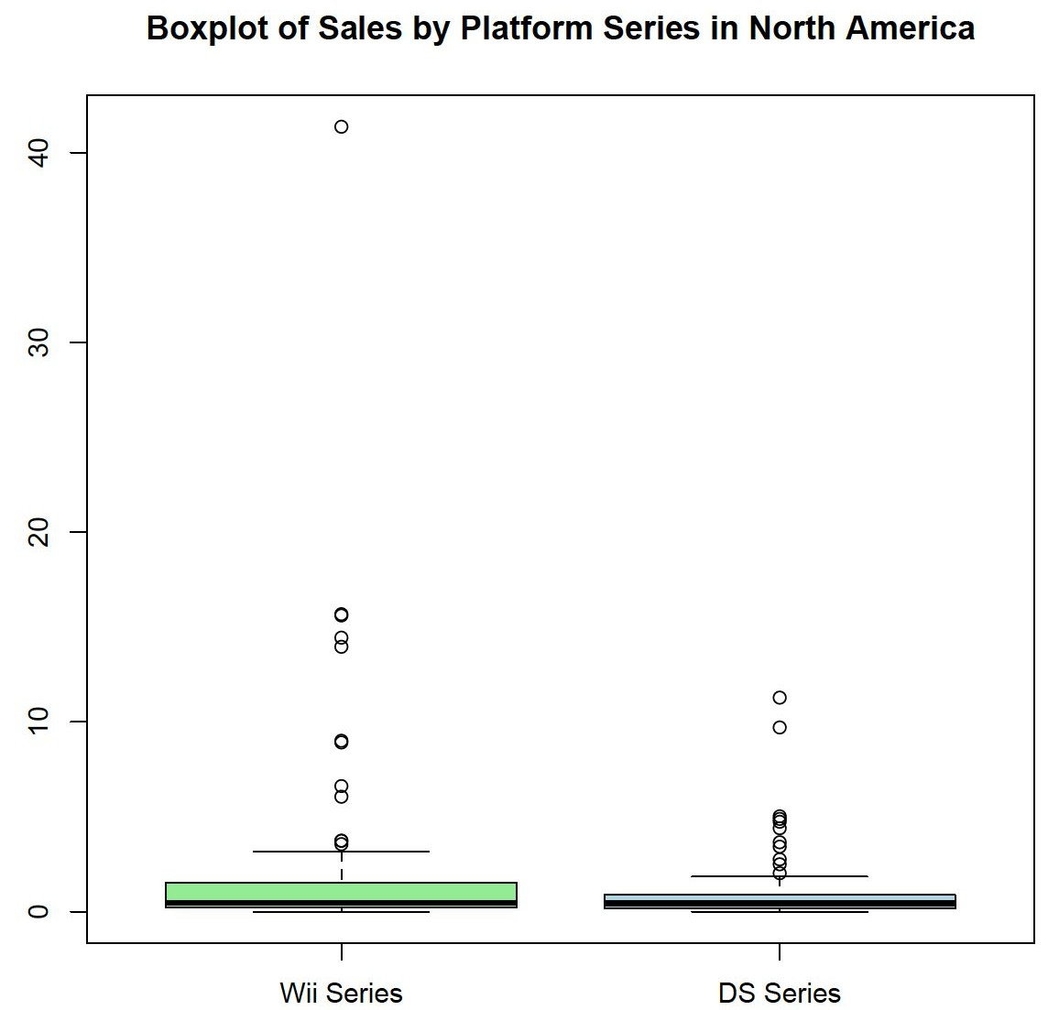
16

Slide 17
Console games are more popular in Europe
17

Slide 18
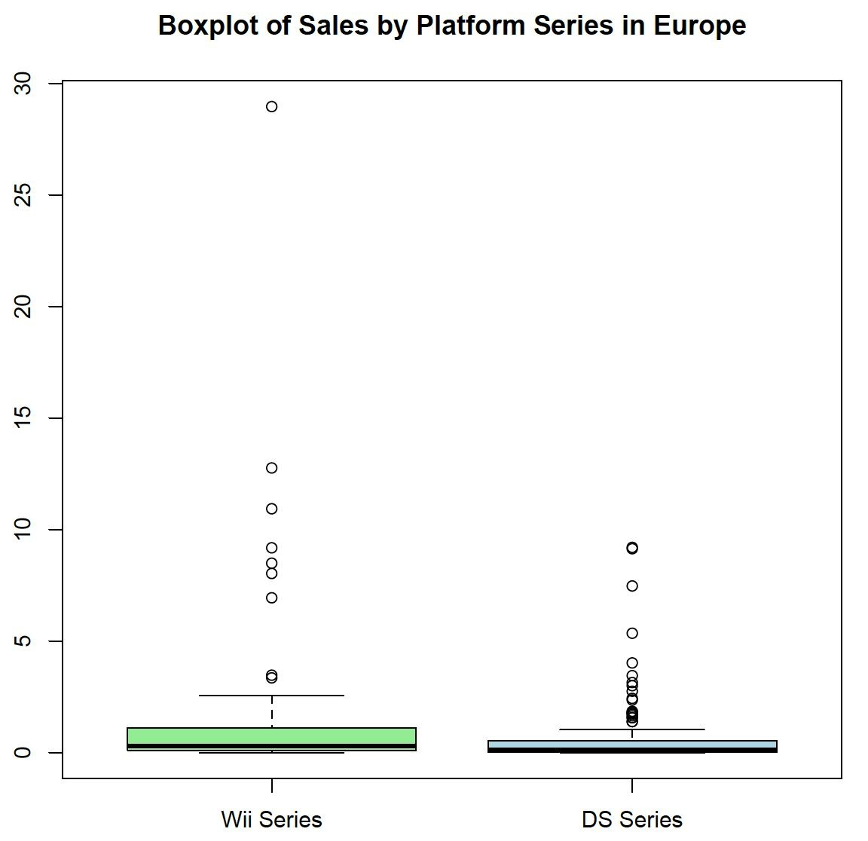
18

Slide 19
Handheld games are more popular in Japan
19

Slide 20
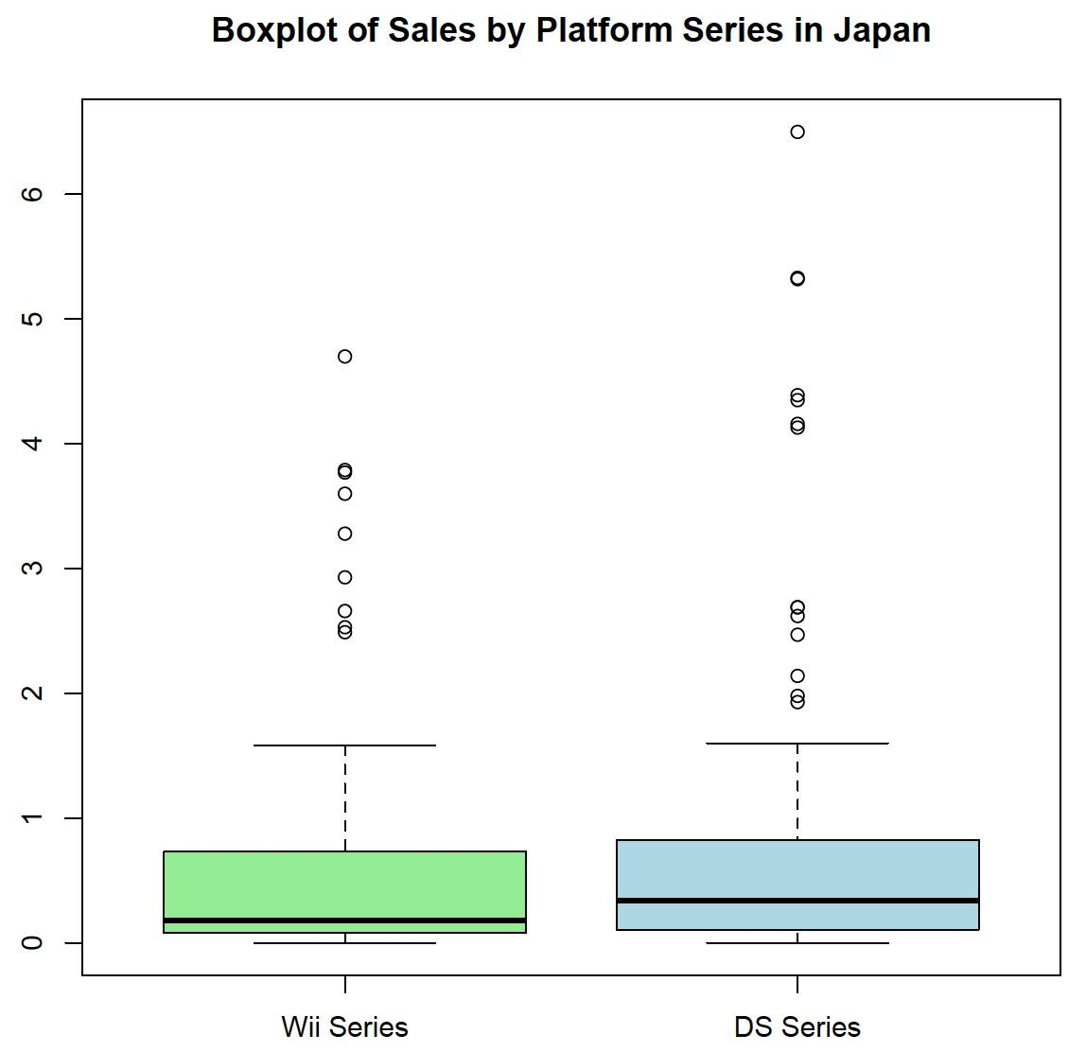
20

Slide 21
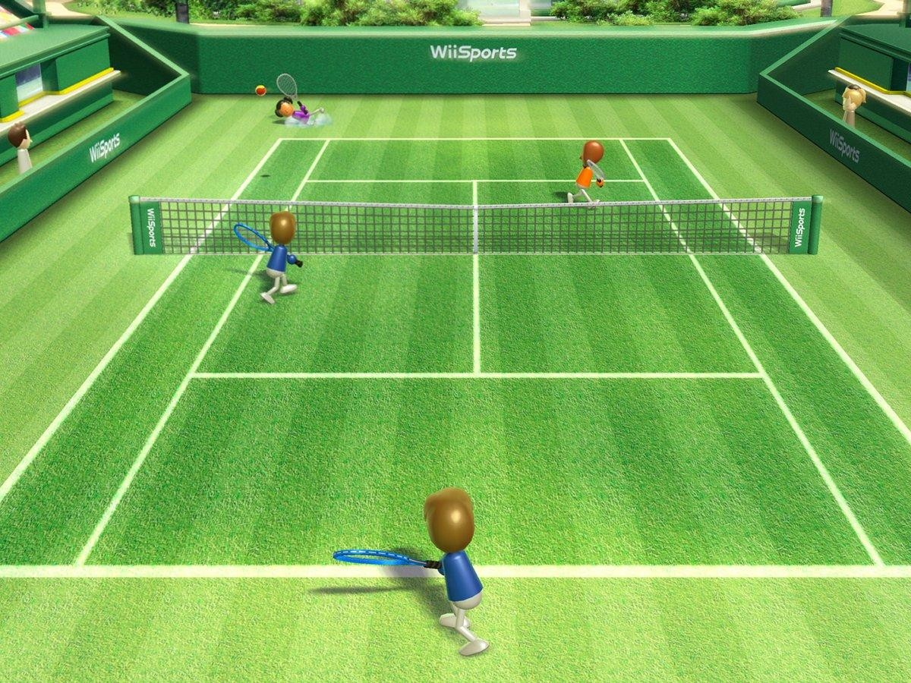
Sports games dominate North American sales
21

Slide 22
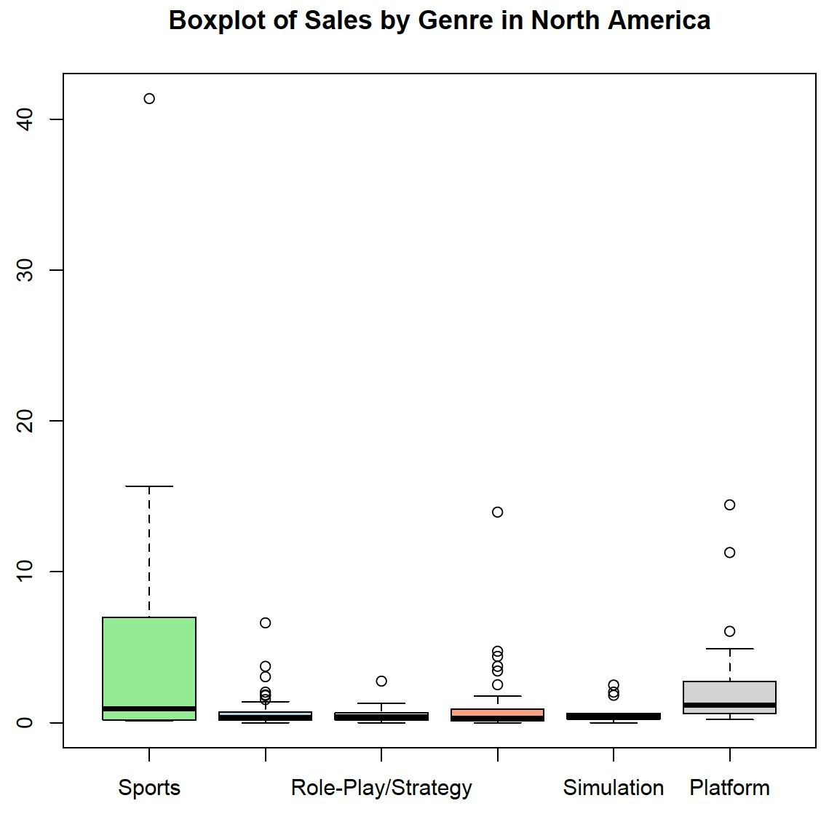
22

Slide 23

Sports games also dominate Europe sales
23

Slide 24
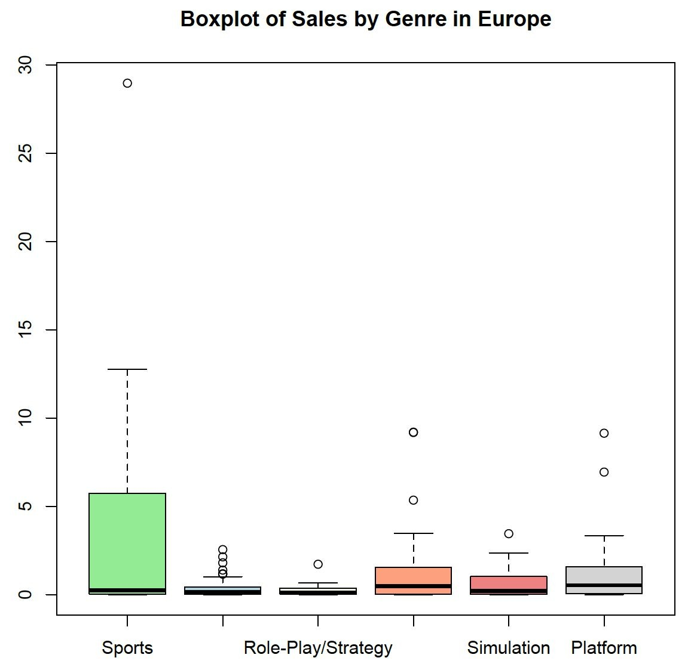
24

Slide 25
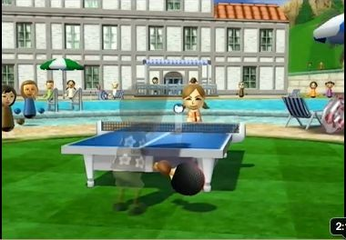
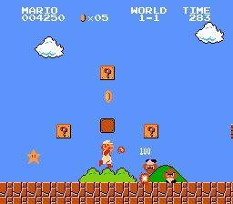
Platform and sports games had highest sales in Japan
25

Slide 26
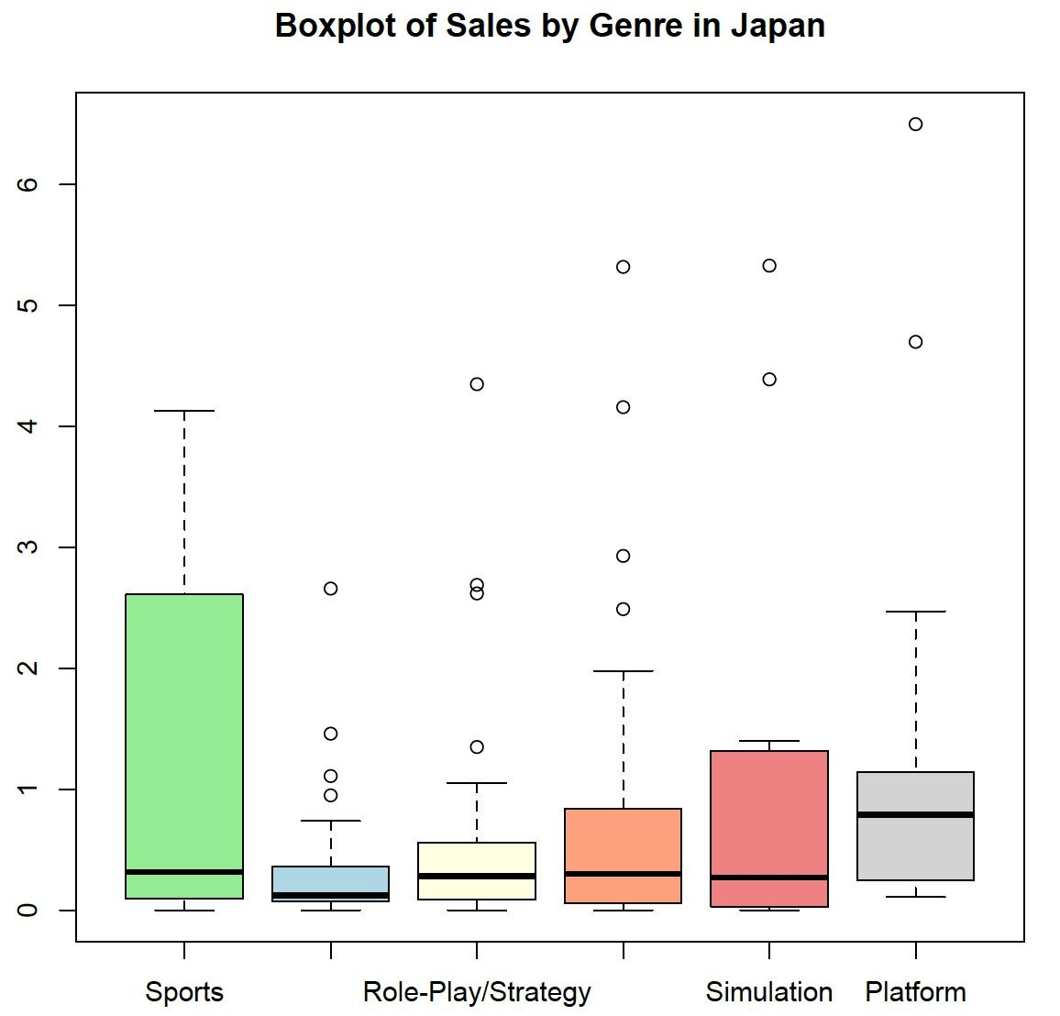
26

Slide 27

T-test & Confidence Interval
27
Null Hypothesis: there is no relationship between sales and platforms.
▸ North America Sales
▹ p-value = 0.01476
▹ 95% confidence interval
▸ Europe Sales
▹ p-value = 0.05623
▹ 95% confidence interval
▸ Japan Sales
▹ p-value = 0.3857
▹ 95% confidence interval

Slide 28

Effect Size
28
Still matters to video games industry!!!
▸ North America
▹ 0.34655
▸ Europe
▹ 0.2705829
▸ Japan
▹ 0.122499

Slide 29
Multiple Regression
29
Coefficients:
 | Genre | Platform | Critic Score | User Score | Rating
North America Sales | -0.36496 | -1.37065 | 0.08650 | -0.23085 | -1.01131
Europe Sales | -0.28032 | -0.80316 | 0.06813 | -0.25136 | -0.75405
Japan Sales | 0.00649 | 0.08407 | 0.03336 | -0.06506 | -0.29946

Slide 30
Formula for Predicting Sales
30
▸ North America Sales = 1.76 - 0.36(Genre) - 1.37(Platform) + 0.087(Critic Score) - 1.01(Rating)
▸ Europe Sales = 1.31 - 0.28(Genre) - 0.803(Platform) + 0.068(Critic Score) - 0.75(Rating)
▸ Japan Sales = -0.96 + 0.033(Critic Score) - 0.299(Rating)

Slide 31
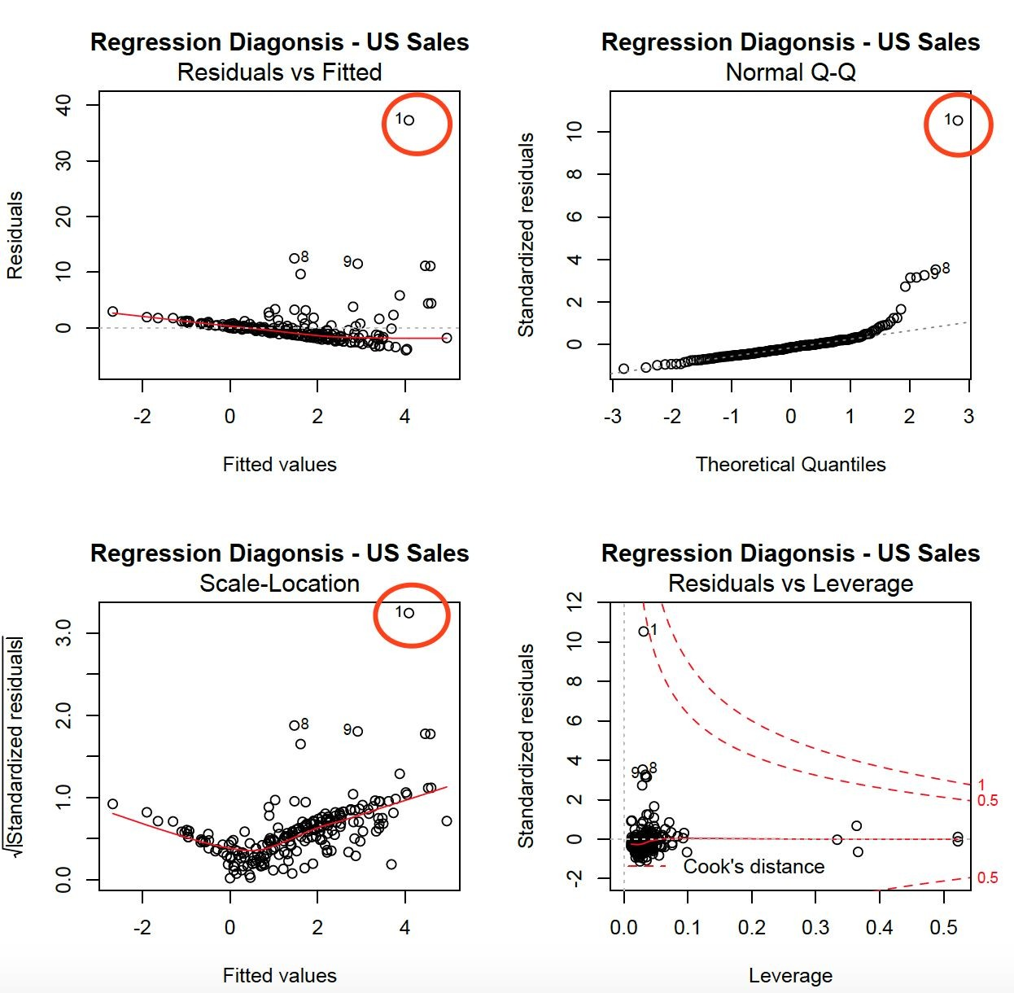

Regression Diagnostic
31

Slide 32
32
4.
Conclusion

Slide 33

Recommendations for Nintendo
33
Focus on Sports globally, Platform in Japan
Make console games for North
America and Europe, portable for Japan

Slide 34





Global strategy
34

Slide 35



35
Where marketing matters
Critic Score is more influential than User Score to drive sales

Slide 36


More recommendations for Nintendo
36
North America and Europe
Japan

Slide 37
37
THANKS!
Any questions?

Slide 38
Appendix - Two way table
38
Count of Games by Genre in Each Platform
 | Wii Series | DS Series
Sports | 16 | 8
Actions/Adventure | 25 | 23
Role-Play/Strategy | 11 | 29
Misc/Puzzle | 19 | 34
Simulation | 4 | 9
Platform | 14 | 13

